Slide 1


OSHA Injury and Illness Recordkeeping
Pat Hagge, CSP
Senior Risk Control Advisor
Allison Fultineer, CSP
Senior Risk Control Advisor

Slide 2

Remember!
OSHA injury and illness recordkeeping and workers’ compensation insurance are independent of one another!
Treatment away from the workplace does not automatically constitute a “recordable” injury.
Inaccurate recordkeeping could result in an OSHA inspection and significant fines.
2
| Flood and Peterson

Slide 3
Who Must Comply?
Employers with 11 or more workers employed by the company at any time during the calendar year, unless included on OSHA’s “partially-exempt” list.
Headcount includes:
  Full-time
  Part-time
  Temporary
  Seasonal Employees
3
| Flood and Peterson

Slide 4
Partially-Exempt
Employers with 10 or fewer employees, regardless of industry
Employers in low-hazard industries
  Retail, finance, insurance
4
| Flood and Peterson

Slide 5
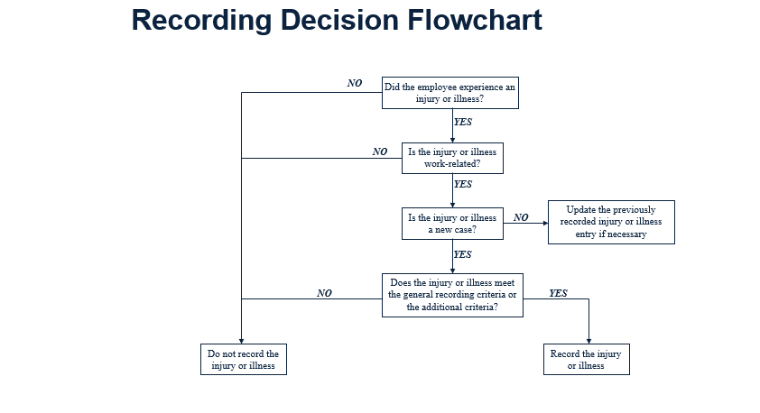
5
| Flood and Peterson

Slide 6
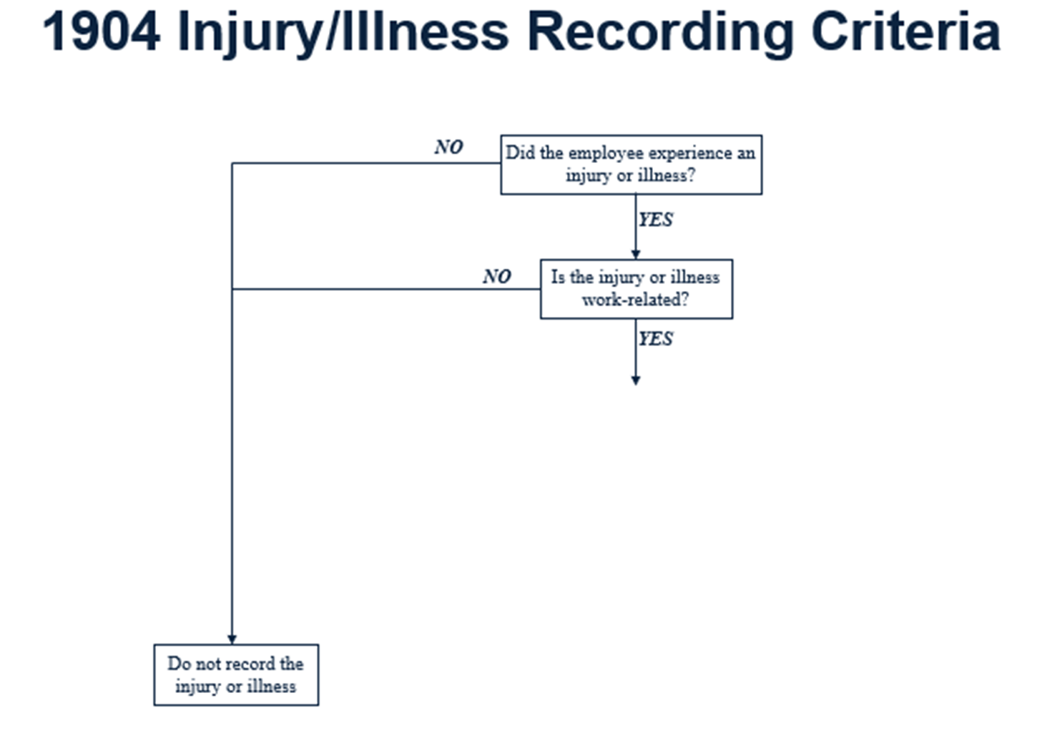
6
| Flood and Peterson

Slide 7
1904.5 – Work-Relatedness
A case is considered work-related if an event or exposure in the work environment either caused or contributed to the resulting condition
A case is considered work-related if an event or exposure in the work environment significantly aggravated a pre-existing injury or illness
Work-relatedness is presumed for injuries and illnesses resulting from events or exposures occurring in the work environment
7
| Flood and Peterson

Slide 8
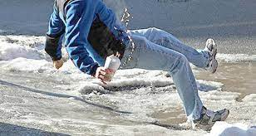
Work Environment
OSHA defines “work environment” as “the establishment and other locations where one or more employees are working or are present as a condition of their employment”.
8
| Flood and Peterson

Slide 9
1904.5 – Exceptions
Present as a member of the general public
Symptoms arising in work environment that are solely due to non-work-related event or exposure
Voluntary participation in wellness program, medical, fitness or recreational activity
Eating, drinking or preparing food or drink for personal consumption
9
| Flood and Peterson

Slide 10

1904.5 – Exceptions (cont.)
Personal tasks outside assigned working hours
Personal grooming, self medication for non-work-related condition, or intentionally self-inflicted
Common cold or flu
Motor vehicle accident in parking lot/access road during commute
Mental illness, unless employee voluntarily provides a medical opinion from a physician or licensed health care professional (PLHCP) having appropriate qualifications and experience that affirms work relatedness
10
| Flood and Peterson

Slide 11
1904.5 – Travel Status
An injury or illness that occurs while an employee is on travel status is work-related if it occurred while the employee was engaged in work activities in the interest of the employer
Home away from home
Detour for personal reasons is not work-related
11
| Flood and Peterson

Slide 12
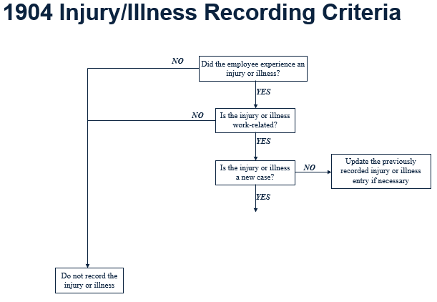
12
| Flood and Peterson

Slide 13
1904.6 – New Case
A case is new if:
  The employee has not previously experienced a recordable injury or illness of the same type that affects the same part of the body; or
  The employee previously experienced a recordable injury or illness of the same type that affects the same part of the body, but had recovered completely and an event or exposure in the work environment caused the signs and symptoms to reappear
13
| Flood and Peterson

Slide 14
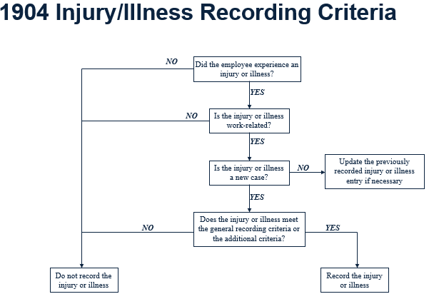

14
| Flood and Peterson

Slide 15
1904.7 – General Recording Criteria
An injury or illness is recordable if it results in one or more of the following:
  Death
  Days away from work
  Restricted work activity
  Transfer to another job
  Medical treatment beyond first aid
  Loss of consciousness
  Significant injury or illness diagnosed by a PLHCP
Cancer
Chronic irreversible disease
Punctured eardrum
Fractured or cracked bone or tooth
15
| Flood and Peterson

Slide 16
1904.7(b)(3) Days Away Cases
Record if the case involves one or more days away from work
Check the box (column H) for days away cases and count the number of days (column K)
Do not include the day of injury/illness
16
| Flood and Peterson

Slide 17
1904.7(b)(3) – Days Away Cases
Day counts (days away or days restricted)
  Count the number of calendar days the employee was unable to work (include weekend days, holidays, vacation days, etc.)
  Cap day count at 180 days away and/or days restricted (columns K and L)
  May stop day count if employee leaves company for a reason unrelated to the injury or illness
  If a medical opinion exists, employer must follow that opinion
17
| Flood and Peterson

Slide 18
1904.7(b)(4) – Restricted Work
Restricted work activity occurs when:
  An employee is kept from performing one or more routine functions (work activities the employee regularly performs at least once per week) of his or her job; or
  An employee is kept from working a full workday; or
  A PLHCP recommends either of the above
18
| Flood and Peterson

Slide 19
1904.7(b)(4) – Restricted Work
Record if the case involves one or more days of restricted work or job transfer
Check the box for transfer/restriction (column I) cases and count the number of days (column L)
Do not include the day of injury/illness
19
| Flood and Peterson

Slide 20
1904.7(b)(4) – Job Transfer
Job transfer
  An injured or ill employee is assigned to a job other than his or her regular job for part of the day
  A case is recordable if the injured or ill employee performs his or her routine job duties for part of a day and is assigned to another job for the rest of the day
20
| Flood and Peterson

Slide 21
1904.7(b)(5) – Medical Treatment
Medical treatment* is the management and care of a patient to combat disease or disorder.
It does not include:
  Visits to a PLHCP solely for observation or counseling
  Diagnostic procedures
  First aid
*Dorland’s Illustrated Medical Dictionary
21
| Flood and Peterson

Slide 22

1904.7(b)(5) – First Aid (Not Recordable)
Using nonprescription medication at nonprescription strength
Tetanus immunizations
Cleaning, flushing, or soaking surface wounds
Wound coverings, butterfly bandages, Steri-Strips
Hot or cold therapy
Non-rigid means of support
Temporary immobilization device used to transport accident victims
22
| Flood and Peterson

Slide 23
1904.7(b)(5) – First Aid (Not Recordable)
Drilling of fingernail or toenail, draining fluid from blister
Eye patches
Removing foreign bodies from eye using irrigation or cotton swab
Removing splinters or foreign material from areas other than the eye by irrigation, tweezers, cotton swabs or other simple means
Finger guards
Massages
Drinking fluids for relief of heat stress
23
| Flood and Peterson

Slide 24

Misc. Issues
Record all work-related needlesticks and cuts from sharp objects that are contaminated with another person’s blood or OPIM
Record a case where an employee is exposed to someone with a known case of active tuberculosis, and subsequently develops a TB infection.
Record all work-related cases involving loss of consciousness
24
| Flood and Peterson

Slide 25
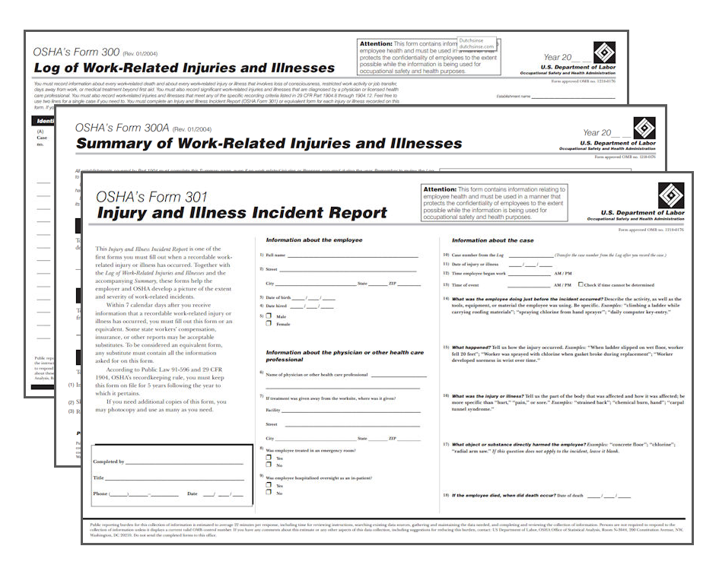
1904.29 - Forms
OSHA Form 300, Log of Work-Related Injuries and Illnesses
OSHA Form 300A, Summary of Work-Related Injuries and Illnesses
OSHA Form 301, Injury and Illness Incident Report
https://www.osha.gov/recordkeeping/forms
25
| Flood and Peterson

Slide 26
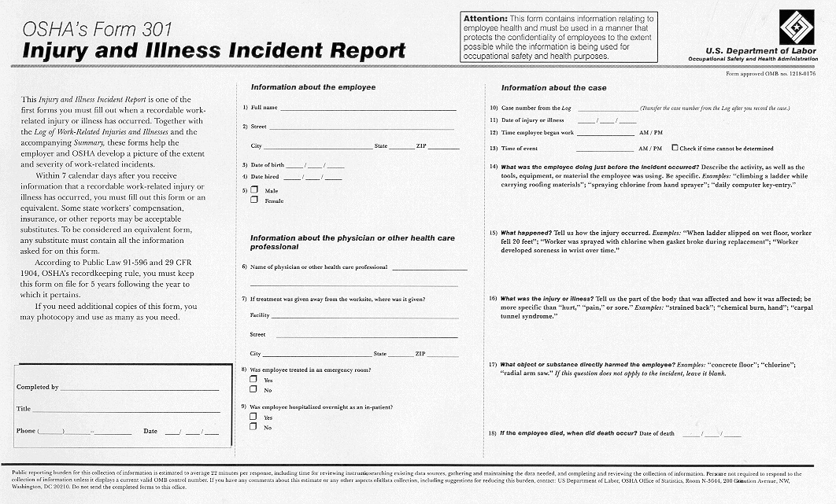
26
| Flood and Peterson

Slide 27
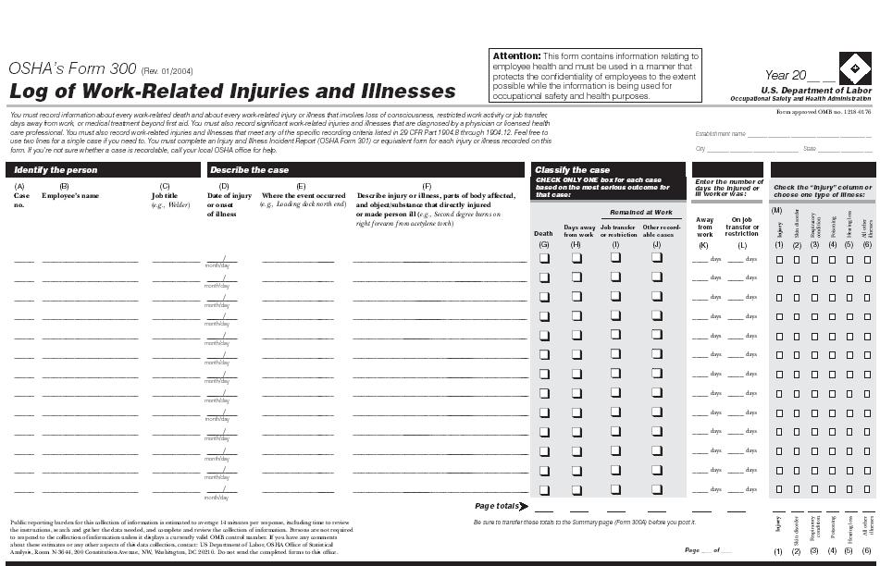
27
| Flood and Peterson

Slide 28
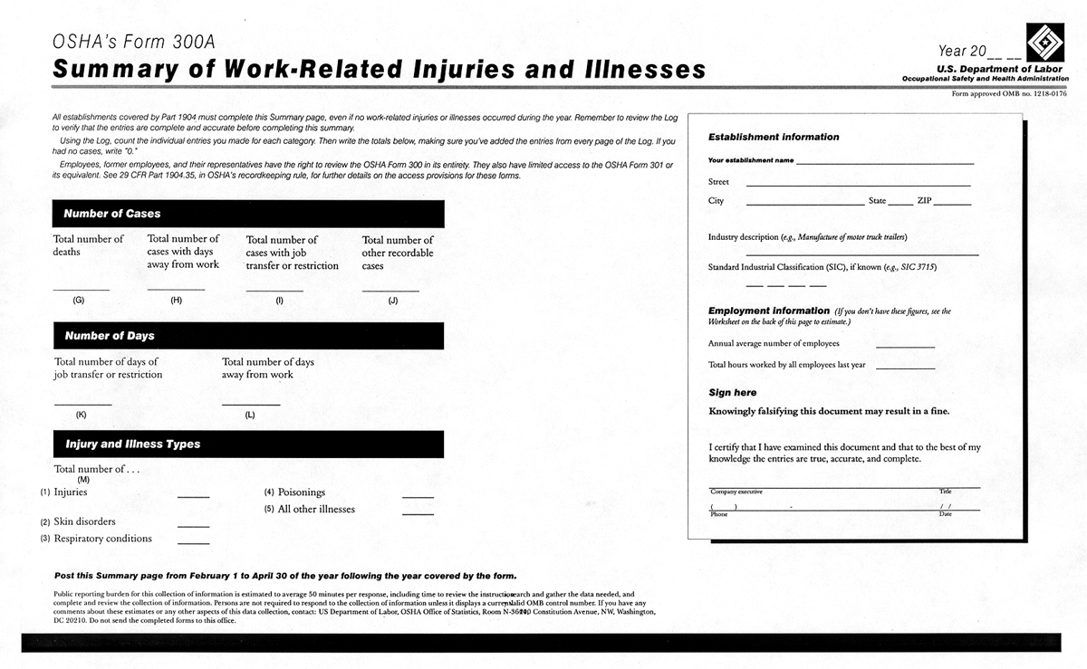
28
| Flood and Peterson

Slide 29
1904.29 - Forms
Must enter each recordable case on the forms within 7 calendar days of receiving information that a recordable case occurred
An equivalent form has the same information, is as readable and understandable, and uses the same instructions as the OSHA form it replaces
Forms can be kept on a computer as long as copies can be provided within 4 business hours
29
| Flood and Peterson

Slide 30
INJURY RATES
TRIR – Total Recordable Injury Rate
DART – Days Away, Restricted, or Transferred
Number of Incidents x 200,000
Employee Hours
TRIR (OSHA 300: Number of Incidents = Column G, H, I, J)
DART (OSHA 300: Number of incidents = Columns H & I)
30
| Flood and Peterson

Slide 31
1904.29 – Privacy Protection
Enter “privacy case” (not the employee name) on the OSHA Form 300 for cases involving:
  An injury or illness to an intimate body part or reproductive system
  An injury or illness resulting from sexual assault
  Mental illness
  HIV infection, hepatitis, tuberculosis
  Needlestick and sharps injuries that are contaminated with another person’s blood or other potentially infectious material
  Employee voluntarily requests to keep name off for other illness cases
31
| Flood and Peterson

Slide 32
1904.30 – Multiple Business Establishments
Keep a separate OSHA Form 300 for each establishment that is expected to be in operation for more than a year
May keep one OSHA Form 300 for all short-term establishments
Each employee must be linked with one establishment
32
| Flood and Peterson

Slide 33
1904.31 – Covered Employees
Employees on payroll
Employees not on payroll who are supervised on a day-to-day basis
Exclude self-employed and partners
Temporary help agencies should not record the cases experienced by temp workers who are supervised by the host employer
33
| Flood and Peterson

Slide 34

1904.32 – Annual Summary
Review OSHA Form 300 for completeness and accuracy, correct deficiencies
Complete OSHA Form 300A
Company Officer Signature
Post summary
  From Feb.1 to April 30 of the year following the year covered by the summary
Electronic Submission*
  For certain establishments
  No later than March 2nd
34
| Flood and Peterson

Slide 35
1904.33 – Retention and Updating
Retain forms for 5 years following the year that they cover
Update the OSHA Form 300 during that period
Do not need to update the OSHA Form 300A or OSHA Form 301
35
| Flood and Peterson

Slide 36
Electronic Submission of Injury and Illness Records
Injury Tracking Application –
300A Due March 2nd
Establishments with 250 or more employees that are currently required to keep OSHA injury and illness records.
Establishments with 20-249 employees that are listed in Appendix A (hazardous industries).
  Utilities, construction, manufacturing, warehousing, transportation
36
| Flood and Peterson

Slide 37
Electronic Submission of Injury and Illness Records
Injury Tracking Application –
300, 300A, 301 Due March 2nd
Establishments with 100 or more employees in designated high hazard industries (Appendix B).
  Agriculture, certain manufacturing, warehousing/storage, certain wholesalers, certain retailers, hospitals/care facilities, transportation
37
| Flood and Peterson

Slide 38

OSHA Reporting Requirements
All covered employers must report the following to OSHA:
All work-related fatalities within 8 hours
All work-related in-patient hospitalizations of one or more employees within 24 hours
All work-related amputations within 24 hours
All work-related losses of an eye within 24 hours
EXCEPTION: Do not report motor vehicle accidents that occur on public streets or highways, unless the incident occurs in a construction zone.
38
| Flood and Peterson

Slide 39


How to Report a Fatality or Severe Injury
www.osha.gov/report
By telephone to the nearest OSHA office during normal business hours.
By telephone to the 24-hour OSHA hotline (1-800-321-OSHA or 1-800-321-6742).
Online: www.osha.gov/pls/ser/serform.html
39
| Flood and Peterson

Slide 40
Common Misconceptions (Everything on this slide is false!)
Flood & Peterson maintains OSHA logs for their clients
It is okay to wait until year-end to complete your OSHA logs
Workers’ compensation claim = OSHA recordable incident
Doctor’s visit = OSHA recordable incident
40
| Flood and Peterson

Slide 41

Questions?
41
| Flood and Peterson

Slide 42

Contact Us
Pat Hagge, CSP
Senior Risk Control Advisor
970-266-7115
phagge@floodpeterson.com
Allison Fultineer, CSP
Senior Risk Control Advisor
970-266-7162
afultineer@floodpeterson.com

