Slide 1


November 1, 2024
The Keys To Defending Auto Claims So They Do Not Go Nuclear
Tracey Lazarus, Esq.
Director of Risk Control
Flood and Peterson

Slide 2


AGENDA OVERVIEW
Questions on Verdicts
Litigation Climate Today
Lessons Learned From Verdicts
a. Negligent Hiring
b. Negligent Supervision and Training
c. Negligent Operation of the Vehicle
d. Negligent Entrustment of the Vehicle
Failure to Retain Documents, Black Box or Telematics
Pre-Accident Activities You Should Undertake
6. What to Do If You Get Sued
2
| Flood and Peterson

Slide 3
QUESTION NUMBER 1
FACTS:
A tractor trailer blocked the road as it backed into a driveway. A van was driving down the road, did not see the tractor trailer blocking the road and hit it resulting in the van driver’s death. The deceased’s parents sued the trucking company and driver alleging negligent operation of a vehicle and negligent supervision. The deceased was in his 20’s.
The jury found the driver was in the course and scope of employment when the accident occurred and apportioned liability at 65% for the driver; 20% trucking company and 10% to the owner of the trucking company.
HOW MUCH WAS THE VERDICT?
$10 million c. $200 million
$100 million d. $247 million
3
| Flood and Peterson
The Keys To Defending Auto Claims

Slide 4
QUESTION NUMBER 2
FACTS:
This case involves a rear-end collision where the commercial truck’s driver rear-ended the plaintiff (“injured party”) causing neck and back injuries to the plaintiff who was in the car the commercial driver hit. The driver of the commercial vehicle had marijuana and methamphetamine in his system and 3 traffic violations on his record in the preceding three months. The Plaintiff sued the truck driver and trucking company alleging the company failed to follow its own internal hiring and training policies and for punitive damages. The jury awarded both compensatory and punitive damages and found the company liable for all damages and the driver liable for 30% (the driver had no assets).
HOW MUCH WAS THE VERDICT?
$30 million c. $101 million
$56 million d. $210 million
4
| Flood and Peterson
The Keys To Defending Auto Claims

Slide 5
QUESTION NUMBER 3
FACTS:
A tractor-trailer owned by a company ran a red-light and broadsided a SUV. The driver of the SUV and her son suffered traumatic brain injuries (“TBIs) and other injuries and the driver’s daughter alleged PTSD from watching her mother and brother being injured. The brother and sister were minors. A lawsuit was filed against the driver of the tractor-trailer as well as the owner of the truck alleging the company negligently entrusted the truck to the driver and thus was vicariously liable.
HOW MUCH WAS THE VERDICT?
$66 million c. $48 million
$99 million d. $70.6 million
5
| Flood and Peterson
The Keys To Defending Auto Claims

Slide 6
Litigation Atmosphere in the United States Today

Slide 7
The Keys To Defending Auto Claims
Reptile Theory: Jurors are being asked to be the policeman of their communities and keep their community safe from companies who place profit over safety performance or payment)
Social inflation
Why Are Jury Verdicts So Excessive
Litigation funding (Camp Lejeune, Baby powder case)
Distrust of corporate America and the judicial system
Distrust of Corporate America and the judicial system
Inflated value of money
7
| Flood and Peterson

Slide 8
The Keys To Defending Auto Claims
REPTILE THEORY
Based upon a book entitled Reptile: The 2009 Manual of the Plaintiff’s Revolution by David Ball and Don Keenan.
The reptile theory focuses on safety and security issues through the use of statutes, safety handouts and industry standards.
The point is to show how a company violated any of these three areas so they can argue the defendant company does not care about keeping you, the juror, and the plaintiff safe.
8
| Flood and Peterson

Slide 9
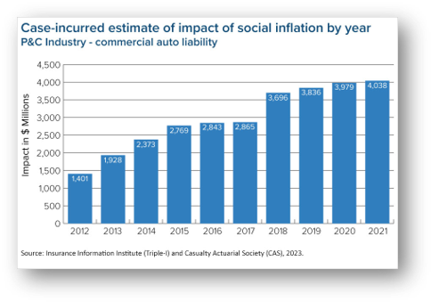
The Keys To Defending Auto Claims
SOCIAL INFLATION
Social inflation refers to how insurers’ claims costs are increasing above general economic inflation. The “social” represents shifting social and cultural attitudes about who is responsible for absorbing risks.
A 2022 study by the Insurance Institute and the Casualty Actuarial Society found that social inflation accounted for $20 billion in commercial auto claims between 2010 and 2019 and the number keeps growing.
Commercial auto (especially trucking companies) professional and product liability cases as well as D&O insurance cases are the most affected by social inflation.
Tracey Lazarus, Esq.
Director of Risk Control
9
| Flood and Peterson

Slide 10
SOCIAL INFLATION REMAINS AN ISSUE
10
| Flood and Peterson

Slide 11



The Keys To Defending Auto Claims
LITIGATION FUNDING
Investors are always looking for ways to make money and litigation is a new means to make money. Investors give money to plaintiffs or their attorneys to fund their litigation and in return they receive their money back. In 2022, $3.2 billion was invested funding Plaintiff lawsuits.
There is very little regulation in the lit funding realm. Only nine states require third-party litigation funding registration or licensure.
Litigation funding is used for advertising (Camp Lejuene lawsuit), mass emails, social media in an attempt to indoctrinate potential jurors against a particular company or product.
11
| Flood and Peterson

Slide 12

The Keys To Defending Auto Claims
TRENDS IN COMMERCIAL AUTO CLAIMS
Jurors are Policing Companies
Shifting juror attitudes
Growing belief that companies should take full responsibility for the safety of their products/services and workplaces no matter how impractical or costly
88% of jurors believe companies should take “any and all” precautions
58% believe a corporation “always” has some responsibility even when plaintiff has some negligence
62% think its an “important function” of juries to “send messages to corporations to improve their behavior.”
77% said they favor punitive damages to punish corporations (+ 8% post pandemic)
  https://www.orrick.com/en/insights/groundbreaking-jury-research-reveals-us-jury-attitudes-in-a-polarized-society
  https://www.constitutionstateservices.com/resources/trends-driving-escalating-jury-verdicts citing 2018 DecisionQuest study
12
| Flood and Peterson

Slide 13
Let’s Discuss the Theories Used In Auto Accidents

Slide 14




Negligent Hiring
The employer knew or should have known about an employee’s background which, if known, indicates a dangerous or untrustworthy person and/or behavior.
Have a policy regarding hiring practices and stick to it.
Remember safety must be at the forefront of how and who you hire.
It is important that you obtain yearly MVRs. It is your responsibility as a company to monitor these. You do not want to be at a deposition answering why you did not know your driver had a DUI or multiple traffic violations.
What, if any, background checks do you do? Do you have a pre-employment physical? Is there pre-employment drug testing?
14
| Flood and Peterson

Slide 15




Negligent Supervision and Training
Elements: Company had a duty to supervise the employee; the employer negligently supervised the employee, and the lack of supervision was the proximate cause of the injury to another.
IN YOUR EMPLOYEE MANUAL, SET FORTH EXPECTATIONS FOR DRIVERS, SUPERVISORS AND WHAT TO DO IF/WHEN YOU HAVE AN ACCIDENT.
If a driver is using a new piece of equipment train them on it, document the training and have a retention policy to keep training materials.
Maintain and retain maintenance logs if it is alleged to be an auto accident caused by an equipment failure.
make sure you follow all procedures and safety rules in your employee manual.
15
| Flood and Peterson

Slide 16




Negligent Operation of the Vehicle: What to Consider
Have training often about distracted driving and why it is forbidden. Document the training and attendance.
Do you provide company cell phones? If yes, how often do you review if the driver was using the phone while driving? In your employee manual, set forth expectations for drivers regarding cell phone use in the vehicle.
Do you review the black boxes to determine if a driver was speeding, driving erratically, etc.
What do you do as a company to ensure your driver is driving safely. If you use driver facing cameras, you must have a policy to review the data and what action is taken when you see prohibited behavior.
16
| Flood and Peterson

Slide 17
The Keys To Defending Auto Claims
Know what kind of driver is driving your vehicle. It is your responsibility to determine if they are a safe driver as well as their driving record.
If you use temporary or contract drivers, what steps do you take to make sure they have a good driving record?
Negligent Entrustment
When a person allows an incompetent driver to drive his or her vehicle and that person causes harm to another
Run MVRs
Attempt to have them sign attesting to their qualifications and safety record
Run background checks
17
| Flood and Peterson

Slide 18
FACTORS AFFECTING VERDICTS - TRUCKING
Spinal cord injuries: double the award to $3.5M
Rear-end in working zones: average of $7M
Logbook violation: 100% verdict for plaintiff
Poor driving history: 100% verdict for plaintiff
Fleeing the scene: 100% verdict for the plaintiff
Distracted driving: 90% increase win rate for plaintiff
Fatigue: 90% increase win rate for plaintiff
Expert defense: verdict mean drops down from $3.1 M to $2.7M
Source: https://www.ccjdigital.com/business/article/14939735/large-jury-verdicts-against-trucking-fleets-are-increasing
18
| Flood and Peterson

Slide 19
Telematics:
Should You Use Them

Slide 20

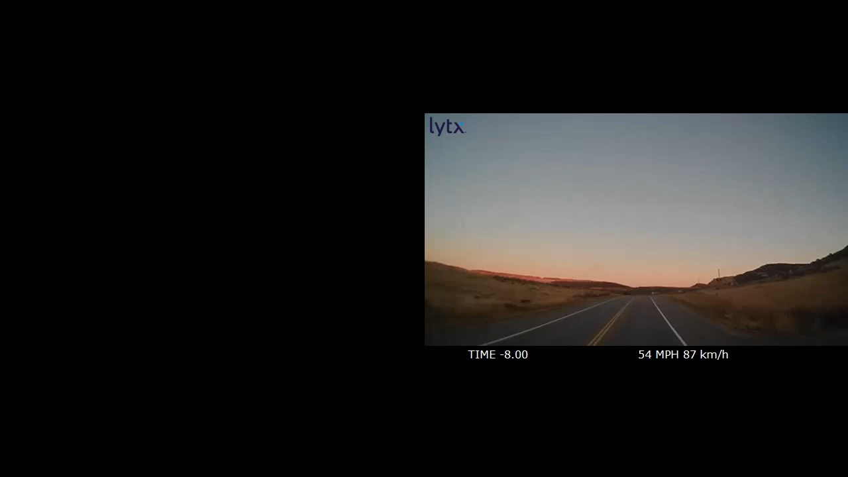

VIDEO
20
| Flood and Peterson

Slide 21
The Keys To Defending Auto Claims
PROS:
Juries will expect you to have them
Most accurate measure of what happened
Can assist with finding no liability or settlement
Can be placed in many places: front and rear cameras, driver facing camera or a combination
CONS:
Expense
Corporate culture
Someone needs to monitor the telematic data and act upon it
Pros And Cons
of Telematics
Tracey Lazarus, Esq.
Director of Risk Control
21
| Flood and Peterson

Slide 22
You Get In An Accident: What Steps Should You Take

Slide 23
ADVICE: FOR THE ACCIDENT SCENE…
ACCIDENT INVESTIGATION
DON’T
DO
Act like you always have an audience
  You are in public and have no enforceable "right to privacy."
Check on the other party
Be aware of electronic communication
  Text/email if you want it documented
Be aware of your surroundings post accident
Document everything
Contact Safety/F&P to discuss filing claim
  Get upset or argue with the other party
  Admit fault
  Post anything on social media
  Get tunnel vision
  Trust your memory
  Offer/Agree to pay for their damages
    This could negatively effect coverage
23
| Flood and Peterson
The Keys To Defending Auto Claims

Slide 24
EVIDENCE TO COLLECT AND PRESERVE
PHYSICAL EVIDENCE:
Event Data Recorder (the Black Box). Make sure the data is not written over or lost
Telematics: video footage. Preserve the entire video. Do not only keep a bit before and after the accident
Photographs of the accident scene (if possible, have your driver take photos)
Vehicle camera footage
DOCUMENTARY EVIDENCE:
Incident report and/or police report
Driver’s driving logs and maintenance logs
All documents to be maintained pre-accident
Complete personnel file
24
| Flood and Peterson
The Keys To Defending Auto Claims

Slide 25



DOCUMENT RETENTION
You do not want the injured party’s attorney claiming you destroyed evidence (Spoliation)
Keep all maintenance logs for the subject vehicle
Training materials used for employee training and attendance at trainings
Employee handbooks
Safety and driving logs
Maintain personnel records that include yearly MVRs
Cell phone
records
25
| Flood and Peterson
The Keys To Defending Auto Claims

Slide 26
The Keys To Defending Auto Claims
BE PREPARED FOR DEPOSITIONS
Be very thorough in what documents are produced in discovery;
Know what your external website says about your safety practices and policies;
Know your internal policies;
Mandate that your attorney prepare you early and often;
Do not fall for questions such as “You believe that safety should come before profits.” or questions like that;
Do not apologize for decisions made;
Have reasonable explanations for policies.
Tracey Lazarus, Esq.
Director of Risk Control
26
| Flood and Peterson

Slide 27
The Keys To Defending Auto Claims
RECAP
Automobile accidents are ripe for large verdicts
Have hiring practices that include full background and driving record checks
Know who you are entrusting your vehicle to
Have a robust safety training on defensive and distracted driving with documented materials and manuals that everyone must attend yearly
Think about deploying telematics
Maintain and preserve all physical and documentary evidence
Be able to sympathetically tell a jury why you are a safety conscious company
Tracey Lazarus, Esq.
Director of Risk Control
27
| Flood and Peterson

Slide 28
The Keys To Defending Auto Claims
UPDATE ON COLORADO’S NEW DAMAGES CAPS
Why the statutory caps are increasing
Effective January 1, 2025, for lawsuits filed on or after January 1, 2025, no matter the injury date
Increases cap on general liability noneconomic damages from $729,790 to $1.5 million
Increases cap for wrongful death noneconomic damages from $679,990 to $2.125 million
Both caps rising by the rate of inflation every two years starting in 2028
Over course of 5 years incrementally increases caps for noneconomic damages in medical malpractice actions from $300,000 to $375,000
Creates new claims for wrongful death resulting from medical malpractice and sets damage cap at $1.575 million over next 5 years
Adds a sibling or the heirs of a sibling of the deceased as parties who may bring a wrongful death action.
28
| Flood and Peterson

Slide 29
The Keys To Defending Auto Claims
DISCLAIMER
The information in this presentation was compiled from sources believed to be reliable for informational purposes only. Any and all information contained herein is not intended to constitute advice (particularly not legal advice). We do not guarantee the accuracy of this information or any results and further assume no liability in connection with this presentation, including any information, methods or safety suggestions contained herein. We undertake no obligation to publicly update or revise any of this information, whether to reflect new information, future developments, events or circumstances or otherwise. The subject matter of this publication is not tied to any specific insurance product nor will adopting these policies and procedures ensure coverage under any insurance policy.
Tracey Lazarus, Esq.
Director of Risk Control
29
| Flood and Peterson

Slide 30
THANK YOU!
Tracey Lazarus, Esq.
Tlazarus@floodpeterson.com
720-977-6031

